Slide 1
Data Import
Programming for Data Analysis (CT127-3-2-PFDA and Version VC1)

Slide 2
Topic & Structure of the lesson
Data Import
Access data included with R
Read data into a vector or list
Read large data files
Read CSV and Excel files
Read from Databases

Slide 3
Learning outcomes
At the end of this topic, you should be able to:
Understand how to read data from various sources.

Slide 4
Key terms you must be able to use
If you have mastered this topic, you should be able to use the following terms correctly in your assignments and exams:
CSV files
Excel files
Databases
Packages and functions that can be used to read data from various sources

Slide 5
1
Access data included with R

Slide 6
Access data included with R
R and some packages come with data included.
To list the data sets in all *available* packages:
data(package = .packages(all.available = TRUE))
To load any data set use the data function:
data(?, package=“?")
Data set name
The package that contain the data set

Slide 7
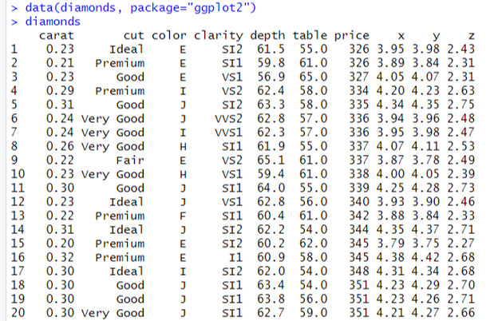
Access data included with R
Example

Slide 8
2
Read data into a vector or list

Slide 9
Read data into a vector or list
Use scan function to read data into a vector or list from the console or file.
IDs= scan(file=“?”)
The path and the name of a file to read data values from

Slide 10
Read data into a vector or list
Example
library(crayon)
IDs= scan(file="C:\\emp.txt")
for(i in IDs)
{
deptID = i %/% 100
if (deptID==1)
{message(red(i))}
else if (deptID==2) {message(green(i))}
else {message(blue(i))}
}
140
253
137
358
279

Slide 11
3
Read large data files

Slide 12
Read large data files
Large files can be slow to read into memory using read.table. fread from the data.table package can be used instead of read.table.
library(data.table)
fread(input=“?”, sep=“?”, header=TRUE)
The full path of the file to be loaded
A logical value indicating whether the file contains the names of the variables as its first line.
The delimiter separating data cells
Example
library(data.table)
f1<-fread(input="c:\\data.csv", sep=",", header=TRUE)

Slide 13
Read large data files
read_delim from the reader package can also be used when working with large data. It returns a tibble, which is an extension of data.frame.
library(reader)
read_delim(file=“?”, delim=“?”, col_names = TRUE)
The full path of the file to be loaded
A logical value indicating whether the file contains the names of the variables as its first line.
The delimiter separating data cells
Example
library(reader)
f2<-read_delim(file="c:\\data.csv", delim=",", col_names =TRUE)

Slide 14
4
Read CSV and Excel files

Slide 15
Read CSV files
A comma-separated values (CSV) file is a delimited text file that uses a comma to separate values.
read.table function is used to read data from a CSV file.
The result of using read.table is a data.frame.
read.csv function, which is a wrapper around read.table with the sep argument preset to a comma (,).

Slide 16
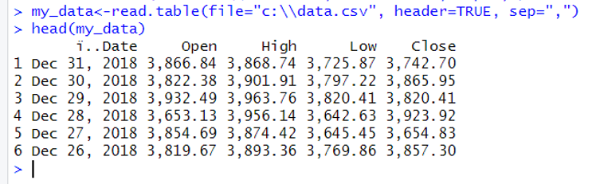
Read CSV files
read.table(file=“?”, header=TRUE, sep=“?")
The full path of the file to be loaded
A logical value indicating whether the file contains the names of the variables as its first line.
The delimiter separating data cells
Example

Slide 17
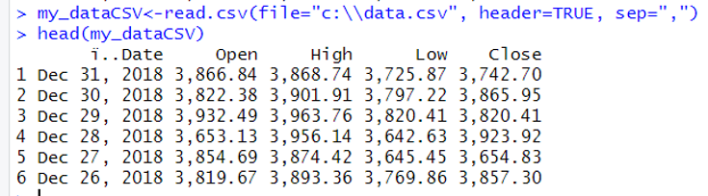
Read CSV files
read.csv(file =“?”, header = TRUE, sep = “,”)
The full path of the file to be loaded
A logical value indicating whether the file contains the names of the variables as its first line.
The delimiter separating data cells
Example

Slide 18
Read Excel files
The package readxl can be used to read Excel files, both .xls and .xlsx.
The result is a tibble rather than a traditional data.frame.
library(readxl)
read_excel(path=“?”, sheet =“?”)
The full path of the file to be loaded
Sheet to read. Either a string (the name of a sheet), or an integer (the position of the sheet)

Slide 19
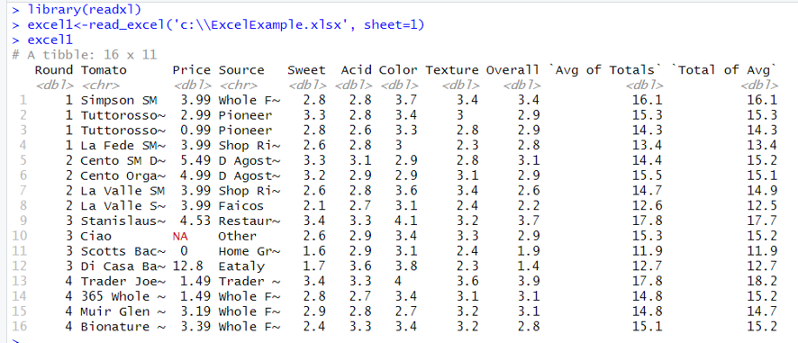
Read Excel files
Example

Slide 20
5
Read from Databases

Slide 21
Read from Databases
There are different types of database software.
The most popular open-source databases have packages such as RPostgreSQL and RMySQL. Other databases without a specific package can make use of the more generic, and aptly named, RODBC package.
Here, a simple SQLite database will be used.

Slide 22
Read from Databases
STEP 1: Load RSQLite library. (Install the library if it is not found in your device.)
library(RSQLite)
STEP 2: Specify the SQLite driver.
drv <- dbDriver('SQLite')
STEP 3: Establish a connection. (Additional arguments are typically the username, password, host, port, the name of the database on the host, or the database file name)
con <- dbConnect(drv, …)

Slide 23
Read from Databases
Example
library(RSQLite)
Load the library
drv <- dbDriver('SQLite')
Specify the driver
Db<-download.file("http://www.jaredlander.com/data/diamonds.db",
destfile = “c:\\ diamonds.db", mode='wb')
con <- dbConnect(drv, "c:\\diamonds.db")
establish a connection
list the tables in a database
> dbListTables(con)
[1] "DiamondColors" "diamonds" "sqlite_stat1"
> dbListFields(con, name='diamonds')
[1] "carat" "cut" "color" "clarity" "depth" "table"
[7] "price" "x" "y" "z"
> dbListFields(con, name='DiamondColors')
[1] "Color" "Description" "Details"
list the fields/columns in a table

Slide 24
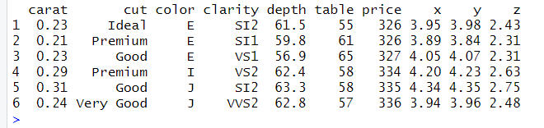
Read from Databases
Example
Retrieve all the elements of all the rows of diamonds table.
library(RSQLite)
drv <- dbDriver('SQLite')
con <- dbConnect(drv, "c:\\diamonds.db")
diamondsTable <- dbGetQuery(con,"SELECT * FROM diamonds",
stringsAsFactors=FALSE)
head(diamondsTable)

Slide 25
Quick Review

Slide 26
Quick Review Questions
How to access data included with R ?
How to read data into a vector or list?
How to read CSV files?
How to read large data files?
How to read Excel files?
How to read from databases?

Slide 27
Learning outcomes
Summary of Main Teaching Points
Access data included with R.
Read data into a vector or list.
Read CSV files.
Read large data files.
Read Excel files.
Read from databases.
You should be able to read data from various sources.

Slide 28
Question and Answer Session
Q & A
Book consultation slots for assistance.

Slide 29
Next Session
Data Visualization
ggplot2 package
Line and path plots
Bar chart
Histogram
Frequency Polygon
Scatter plot
Box plot
Using colors and shapes in plots
Axis and plot labels
Facetting

